Slide 1

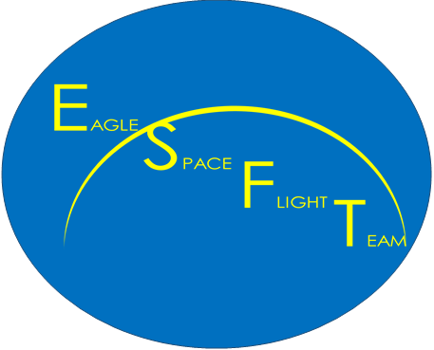


Eagle Space Flight Team
Electronics Team
Brandon Klefman
klefmanb@my.erau.edu
Mentor: Dr. Brian Davis

Slide 2

Outline
Primary Objectives
Secondary Objectives
Hardware Development
Hardware Assembly
Software Development
Test Flights
Challenges
Future Development
Lessons Learned

Slide 3
Primary Objectives
The Electronics telemetry system should…
Track the rocket during the flight.
Measure the pressure around the rocket during the flight.
Transmit the location of the rocket to the ground station during the flight.

Slide 4
Primary Objectives (cont.)
Activate the deployment of the drogue parachute at the apogee of the flight.
Activate the deployment of the main parachute at a preset altitude during descent.
Have a secondary, redundant method of detecting apogee.

Slide 5
Secondary Objectives
The Electronics telemetry system should…
Record the acceleration of the rocket.
Record the gyroscopic rotation of the rocket.
Record the compass orientation of the rocket.
Store all data on the rocket for analysis upon recovery.

Slide 6
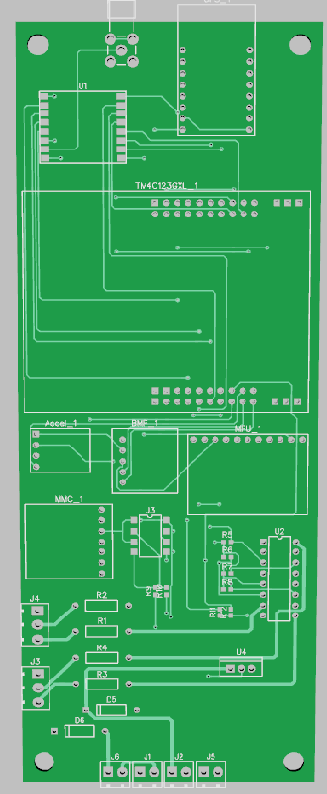
Hardware Development
Custom, student designed printed circuit board
  Integrate GPS, pressure sensor, Inertial Measurement Unit, uSD card, and radio into the printed circuit board.
Capable of activating electric-matches for parachute deployment.
  Requires a nominal current of 0.75 amp for deployment.

Slide 7
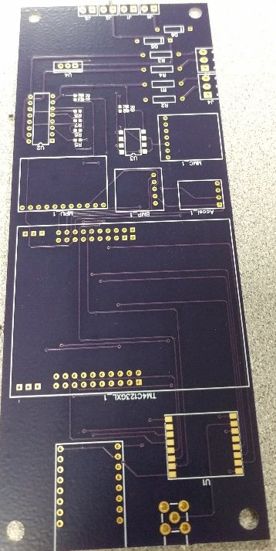
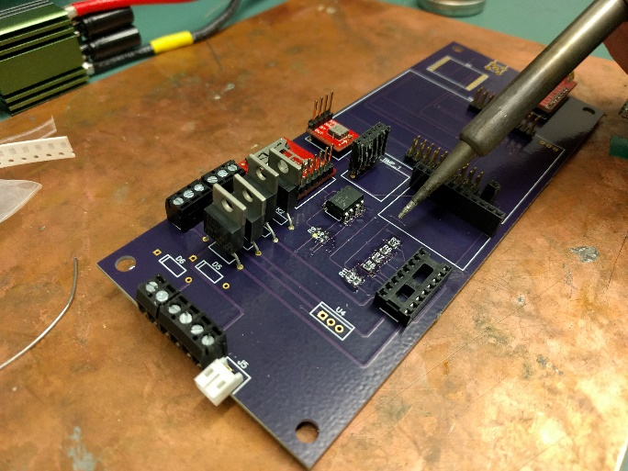
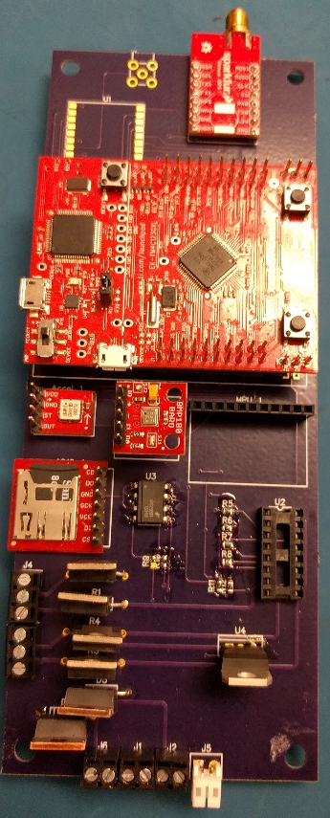
Hardware Assembly
Printed Circuit Board was populated by students
  Required soldering and continuity checks before final board power on.
Fabacademy.org

Slide 8
Software Development
Used libraries available from Texas Instruments to help develop the software
  Sped up the software development process
  Used the Texas Instruments TM4C123GXL development board
Testing is limited to functional tests such as deployment
  Unable perform a full software test without flying aboard the rocket.

Slide 9
Test Flights
First flight resulted in failure of the vehicle, destroying the entire electronics system.
  No data was retrieved from first flight.
Second flight was a successful flight for the rocket.
  Electronics package did not correctly arm or record any data due to a short circuit.
  Electronics package was successfully recovered.

Slide 10
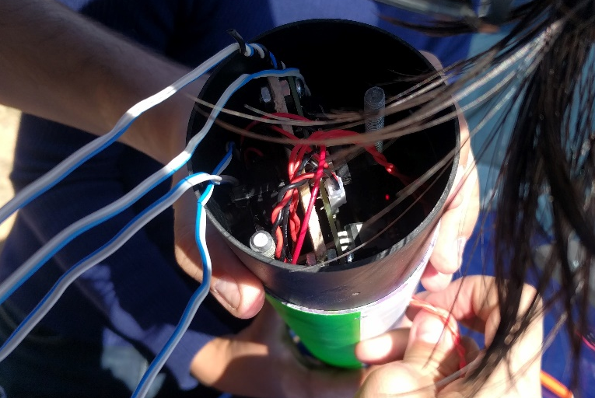
Challenges
Integration
  Extremely challenging to integrate electronics system into the rocket.
    Improved communication between the structures sub-team and the electronics sub-team would ease the difficulties with integration of the electronics payload.
Arming/Disarming electronics
  Cannot arm the system before placing the rocket on the pad for fear of accidentally activating parachute deployment explosives.
  Must develop a simple and reliable way to arm system

Slide 11
Lessons Learned
Cooperation and communication between teams is vital for ease of assembly and integration.
Actual operation of the system is not as simple as it is in a testing environment.
  The operation of the system in the target environment is difficult to plan for, but must be taken into account.

Slide 12
Conclusion
The electronics system has yet to be fully tested.
  Though testing has proven successful validation of most of the electronics system, full validation will require a successful flight.
All Primary and Secondary objectives have yet to be satisfied.
  Future flights will validate the system, including future integration of a radio for tracking.
  Next flight date scheduled for April 29, 2017.

Slide 13
Acknowledgements
Dr. Brian Davis – Project Mentor
Dr. Gary Yale – ERAU Space Grant Coordinator
Dr. Julio Benavides – Eagle Space Flight Team Advisor

Slide 14
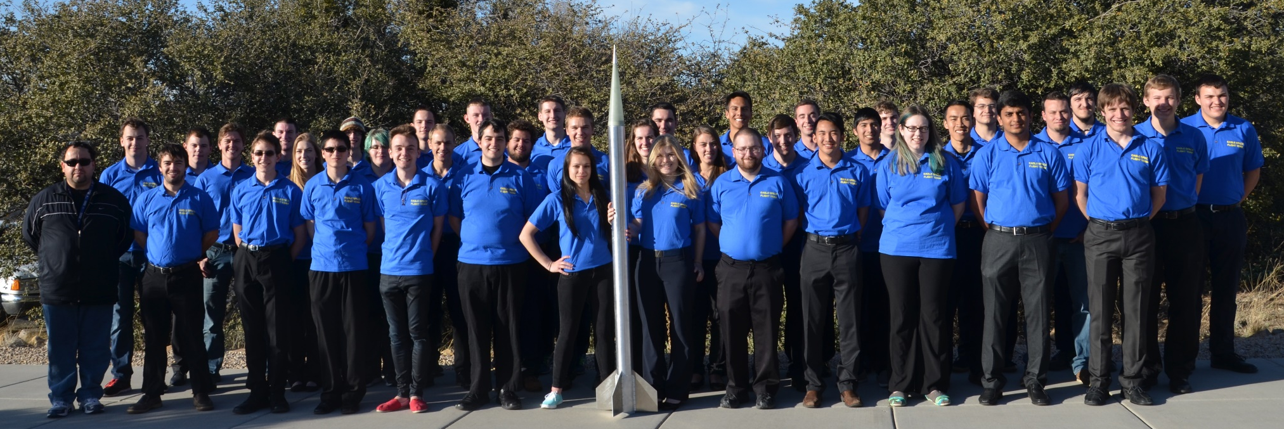
Questions?
Electronics Team Lead:
Brandon Klefman
klefmanb@my.erau.edu
Learn more about the Eagle Space Flight Team:
www.EagleSpaceFlightTeam.com
www.facebook.com/eaglespaceft/
EagleSpaceFlightTeam@gmail.com

